Slide 1
Faculty Information-
GCAD

Slide 2


Dr. Diksha Gupta
Designation - Associate Professor
Experience - 10+ years experience
Achievements – Empanelled Designer at Uttar Pradesh Institute of Design & Research, Lucknow, Innovation Ambassador (Foundation &amp; Advanced Level) – Ministry of Education Innovation Cell & AICTE, Coordinator for ARIIA – Atal Ranking of Institutions on Innovation Achievements with 15+ published research papers.
Contributed extensively to Fashion & Textiles through research, curriculum development, innovation practices, and industry-academia engagement.

Slide 3
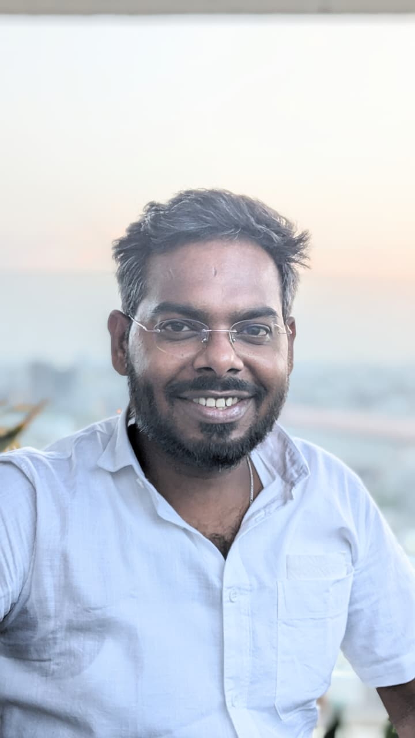
Shubham Bhoskar
Designation - Assistant Professor
Experience - 5+ years experience
Achievements – Master of Design (UX Design), Vivekananda Global University, Bachelor of Science – Interior Design - INIFD, Koregaon Park.

